Slide 1
Natural Language Processing NLP
Instructor: Arun Kumar Rajasekaran

Slide 2
What is NLP?
Natural language processing (NLP) refers to the branch of computer science—and more specifically, the branch of artificial intelligence or AI—concerned with giving computers the ability to understand text and spoken words in much the same way human beings can.
NLP
{computational linguistics (Rule based modeling of human language)
+ Statistics + Machine learning + Deep learning}
//Computational linguistics, human language technology, natural language engineering

Slide 3
The dawn of NLP
~1950
‘Computing machinery and Intelligence’ | ‘Turing test ’
~1960s
SHRDLU, a system written to work with restricted block of words
~1980s
Introduction of machine learning (statistical version)
~1980s
Acceptance of corpus linguistics rather than Chomskyan linguistics theory
~1990s
Moore's law
Abbreviation fact: NLP also stands for Neuro-Linguistic Programming

Slide 4
Basic NLP regimes
Speech recognition
Part of speech tagging
Word sense disambiguation
Named entity recognition
Co-reference resolution
Sentiment analysis
Natural language generation
Some NLP use cases
Spam detection
Machine translation
Virtual assistants and chatbots
Social media sentiment analysis
Text summarization

Slide 5
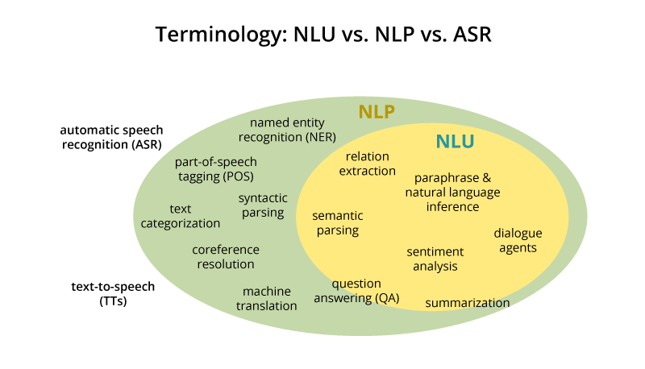

Slide 6
Working overview
Computer vision - pattern recognition of pixels
NLP - pattern recognition to words, sentences, and paragraphs
An outlook
Preprocessing
NLP algorithms
NLG (natural language generation)
Preprocessing
Algorithm
NLG (Natural language generation)

Slide 7
Pre-processing
-Tokenization: breaks down text into smaller semantic units or single clauses
-Part-of-speech-tagging: marking up words as nouns, verbs, adjectives, adverbs, pronouns, etc
-Stemming and lemmatization: standardizing words by reducing them to their root forms
-Stop word removal: filtering out common words that add little or no unique information, for example, prepositions and articles (at, to, a, the).

Slide 8
Employing Algorithm
A rule-based approach
Rule-based systems rely on hand-crafted grammatical rules that need to be created by experts in linguistics, or knowledge engineers. This was the earliest approach to crafting NLP algorithms, and it’s still used today.
Machine learning algorithms
Machine learning models, on the other hand, are based on statistical methods and learn to perform tasks after being fed examples (training data).

Slide 9
Natural Language Generation (NLG)
Natural Language Generation (NLG), a subcategory of Natural Language Processing (NLP), is a software process that automatically transforms structured data into human-readable text.
Data interpretation
Document planning
Sentence Aggregation
Grammaticalization
Language implementation

Slide 10
Levels of NLP in information retrieval
Morphological Analysis
The morphological level of linguistic processing deals with the study of word structures and word formation, focusing on the analysis of the individual components of words. The most important unit of morphology, defined as having the “minimal unit of meaning”, is referred to as the morpheme
[lemmatization; Morphological segmentation; part-of-speech tagging; stemming]
2) Lexical Analysis
The lexical analysis in NLP deals with the study at the level of words with respect to their lexical meaning and part-of-speech. This level of linguistic processing utilizes a language’s lexicon, which is a collection of individual lexemes. A lexeme is a basic unit of lexical meaning; which is an abstract unit of morphological analysis that represents the set of forms or “senses” taken by a single morpheme
[Lexical semantics; Distributional semantics; Named entity recognition; Sentiment analysis; Terminology extraction; Word sense disambiguation]

Slide 11
Levels of NLP in information retrieval
3) Syntactic Analysis
The part-of-speech tagging output of the lexical analysis can be used at the syntactic level of linguistic processing to group words into the phrase and clause brackets. Syntactic Analysis also referred to as “parsing”, allows the extraction of phrases which convey more meaning than just the individual words by themselves, such as in a noun phrase.
[Grammar induction; Sentence breaking; parsing]
4) Semantic Analysis
The semantic level of linguistic processing deals with the determination of what a sentence really means by relating syntactic features and disambiguating words with multiple definitions to the given context. This level entails the appropriate interpretation of the meaning of sentences, rather than the analysis at the level of individual words or phrases.
[Relational extraction; Semantic parsing; Semantic role labelling ]

Slide 12
Levels of NLP in information retrieval
5) Discourse Analysis
The discourse level of linguistic processing deals with the analysis of structure and meaning of text beyond a single sentence, making connections between words and sentences.
[Conference resolution; Discourse analysis]
6) Pragmatic Analysis
The pragmatic level of linguistic processing deals with the use of real-world knowledge and understanding of how this impacts the meaning of what is being communicated. By analyzing the contextual dimension of the documents and queries, a more detailed representation is derived.

Slide 13
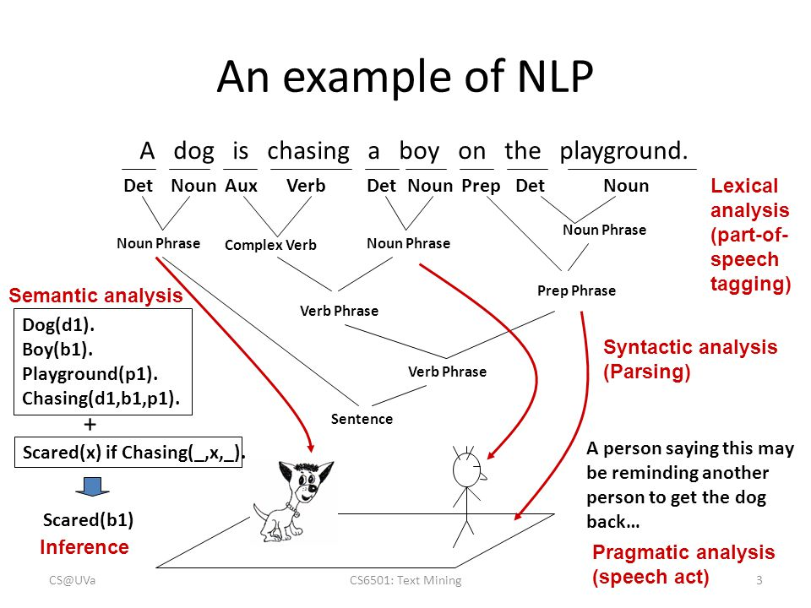

Slide 14
Advancing NLP
Including cognitive linguistics
“the understanding of one idea, in terms of another” which provides an idea of the intent of the author.
For example, consider the English word “big”. When used in a comparison (“That is a big tree”), the author's intent is to imply that the tree is ”physically large” relative to other trees or the authors experience. When used metaphorically (”Tomorrow is a big day”), the author’s intent to imply ”importance”. The intent behind other usages, like in ”She is a big person” will remain somewhat ambiguous to a person and a cognitive NLP algorithm alike without additional information.

Slide 15
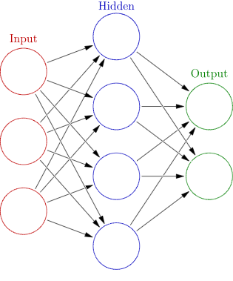
Artificial neural networks in NLP
An artificial neural network (ANN) is a computational nonlinear model based on the neural structure of the brain that is able to learn to perform tasks like classification, prediction, decision-making, visualization, and others just by considering examples.
An artificial neural network consists of artificial neurons or processing elements and is organized in three interconnected layers: input, hidden that may include more than one layer, and output.

Slide 16
Artificial neural networks in NLP
The input layer contains input neurons that send information to the hidden layer. The hidden layer sends data to the output layer. Every neuron has weighted inputs (synapses), an activation function (defines the output given an input), and one output. Synapses are the adjustable parameters that convert a neural network to a parameterized system.
The weighted sum of the inputs produces the activation signal that is passed to the activation function to obtain one output from the neuron. The commonly used activation functions are linear, step, sigmoid, tanh, and rectified linear unit (ReLu) functions.
DNN
A deep neural network (DNN) is an artificial neural network (ANN) with multiple layers between the input and output layers. There are different types of neural networks but they always consist of the same components: neurons, synapses, weights, biases, and functions.

Slide 17
Artificial neural networks in NLP
1. Multilayer perceptron (MLP)
A multilayer perceptron (MLP) has three or more layers. It utilizes a nonlinear activation function (mainly hyperbolic tangent or logistic function) that lets it classify data that is not linearly separable. Every node in a layer connects to each node in the following layer making the network fully connected.
For example, multilayer perceptron natural language processing (NLP) applications are speech recognition and machine translation.

Slide 18
Artificial neural networks in NLP
2. Convolutional neural network (CNN)
A convolutional neural network (CNN) contains one or more convolutional layers, pooling or fully connected, and uses a variation of multilayer perceptrons discussed above. Convolutional layers use a convolution operation to the input passing the result to the next layer. This operation allows the network to be deeper with much fewer parameters.

Slide 19
Artificial neural networks in NLP
3. Recursive neural network (RNN)
A recursive neural network (RNN) is a type of deep neural network formed by applying the same set of weights recursively over a structure to make a structured prediction over variable-size input structures, or a scalar prediction on it, by traversing a given structure in topological order

Slide 20
Artificial neural networks in NLP
4. Recurrent neural network (RNN)
A recurrent neural network (RNN), unlike a feedforward neural network, is a variant of a recursive artificial neural network in which connections between neurons make a directed cycle. It means that output depends not only on the present inputs but also on the previous step’s neuron state. This memory lets users solve NLP problems like connected handwriting recognition or speech recognition.

Slide 21
Artificial neural networks in NLP
5. Long short-term memory (LSTM)
Long Short-Term Memory (LSTM) is a specific recurrent neural network (RNN) architecture that was designed to model temporal sequences and their long-range dependencies more accurately than conventional RNNs

Slide 22
Artificial neural networks in NLP
6. Sequence-to-sequence models
Usually, a sequence-to-sequence model consists of two recurrent neural networks: an encoder that processes the input and a decoder that produces the output. Encoder and decoder can use the same or different sets of parameters.
Sequence-to-Sequence models are mainly used in question answering systems, chatbots, and machine translation. Such multi-layer cells have been successfully used in sequence-to-sequence models for translation in Sequence to Sequence Learning with Neural Networks study .

Slide 23
Artificial neural networks in NLP
7. Shallow neural networks
Besides deep neural networks, shallow models are also popular and useful tools.
For example, word2vec is a group of shallow two-layer models that are used for producing word embeddings. Presented in Efficient Estimation of Word Representations in Vector Space, word2vec takes a large corpus of text as its input and produces a vector space. Every word in the corpus obtains the corresponding vector in this space. The distinctive feature is that words from common contexts in the corpus are located close to one another in the vector space.

Slide 24
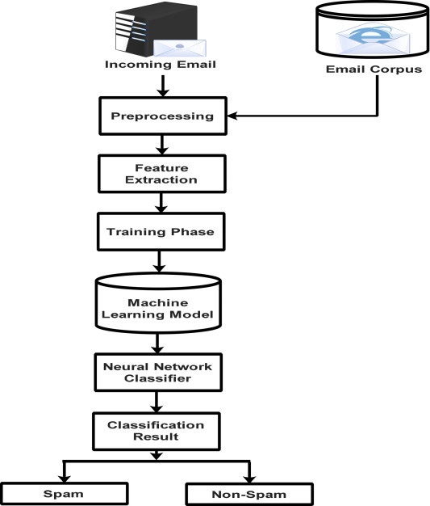
Spam mail classification
Working overview:

Slide 25
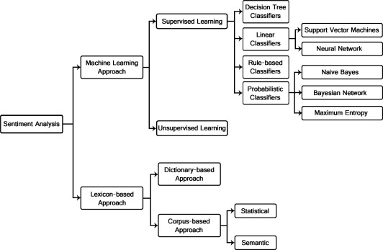
Sentiment analysis
Working overview

Slide 26
Thank you

